Slide 1

Summer Training Report On Bajao Music player App Submitted by - Siddhant Gupta (181500708) Prashant Tomar (181500492) Siddhant Anand (181500707) Hashir Khan (181500387)
Department of Computer Engineering And Application
Institute of Engineering And Technology
GLA University
Mathura – 281406, India
2020

Slide 2
ACKNOWLEDGEMENT
The satisfaction which accompanies the successful completion of the project, is incomplete without the mention of a few names. We take this opportunity to acknowledge the efforts of the many individuals who helped us to make this project possible.
Firstly we would like to express our heartfelt appreciation and gratitude to our project guide Mr. Neeraj Khanna, Technical Trainer , GLA University.
His vision and execution aimed at creating a structure, definition and realism around the project and fostered the ideal environment for us to learn and do. This project is a result of his teaching, encouragement and inputs in the numerous meetings he had with us, despite his busy schedule.
The experience was novel one and we would like to thank all the people, who have lent their valuable time for the completion of the report. Without their consideration it would have been difficult to complete the report.
Mr. Siddhant Gupta
Mr. Prashant Tomar
Mr. Siddhant Anand
Mr. Hashir Khan

Slide 3
ABSTRACT
The functions of playing music and multimedia have become essential in one device as a smart phone since the smart phone appeared. It is very convenient, but it contains controversial arguments about sound quality, so many smart phone users use the music player application. By using these music applications, people start to think about the relationship between music playing and sound quality.
In the last few years, Music players have made it possible to take your whole music collection with you anywhere. It plays a vital role in one’s life. It helps to reduce the stress from one’s mind.
If any person wants to listen the song he simply opens up the application and play the desired song which he wants from the given list of songs.
Our update is less space consuming and also reduces the overuse of RAM. Like in other music player we need more space to be free for its proper running. Its GUI is designed in tri- color, that is, saffron, white and green, the tri-colors of our National Flag. So it is for those users who are patriotic and immensely loves his nation.

Slide 4
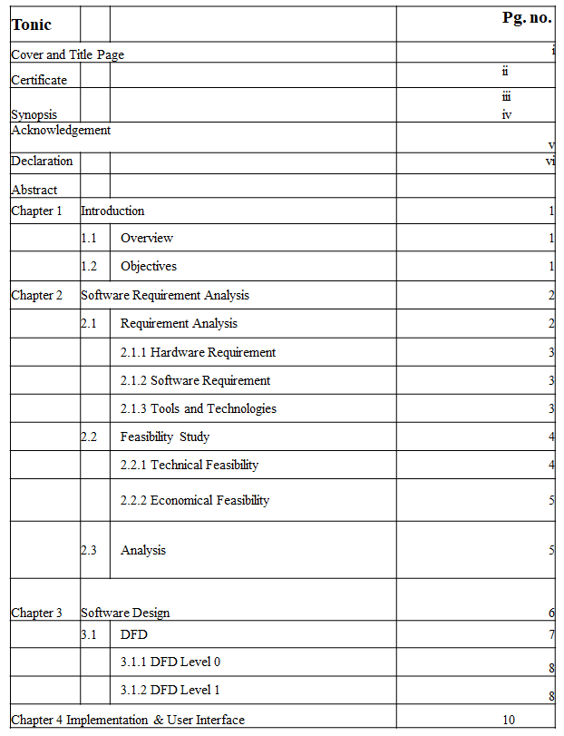
Table of Content

Slide 5
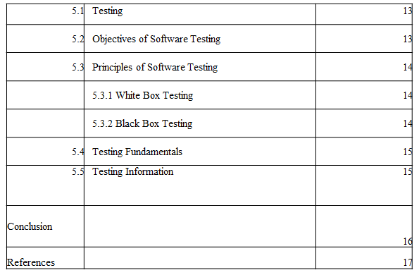

Slide 6
Introduction
1.1 Overview:
Present Problem Statement:
In today’s world various music players have a great design and very attractive GUI but those apps consumes a lot space in your device. To overcome from this issue and to provide a better music player for music lovers and those who only wants to listen songs rather to focusing on its GUI I have made this application. It also consumes less space so users having less space in their device and having less RAM can easily use this application efficiently.
Proposed System:
The Music Player works on almost every android device even after having less storage.
□ By fetching songs from the device we can easily use this application in our low storage devices.
□ To quickly access the songs without your device getting hanged.
1.2 Objective:
The Music Player works on almost every android device even after having less storage.
□ By fetching songs from the device we can easily use this application in our low storage devices.
□ To quickly access the songs without your device getting hanged.

Slide 7
Software Requirement Analysis
System Analysis is a detailed study of the various operations performed by a system and their relationship within and outside the system .It is a systematic technique that defines goals and objectives the goal of the development is to deliver the system in the line with the user’s requirements, and analysis is this process.
System study has been conducted with the following objectives in mind: -
• Identify the client’s need.
• Evaluate the system concept for feasibility.
• Perform economical and technical analysis.
• Allocate functional to hardware, software, people, database and other system elements
• Establish cost and schedule constraints.
• Software expertise is required to successfully attain the objectives.
2.1 Requirement Analysis:
Information gathering is usually the first phase of the software development project. The purpose of this phase is to identify and document the exact requirements for the system. The user’s request identifies the need for a new information system and on investigation re-defined the new problem to be based on MIS, which supports management. The objective is to determine whether the request is valid and feasible before a recommendation is made to build a new or existing Railway System.
The major steps are -
• Defining the user requirements.
• Studying the present system to verify the problem.
• Defining the performance expected by the candidate to use requirement

Slide 8
2.1.1 Hardware Requirements:
Processor: Intel Core i5-7200U (7th Gen)
Processor Speed: 2.5 Ghz
RAM:8 GB
Hard Disk: 20 GB of free space Device: Android device
Android Version: 4.0.3 Ice Cream Sandwich or higher(API 15 or higher)
2.1.2 Software Requirements:
Operating System: Window 10 IDE: Android Studio
2.1.3 Tools &
Technology
• Windows 10
• Android Studio
Technology:
• JAVA is a general-purpose programming language that is class-based, object-oriented, and designed to have as few implementation dependencies as possible.
• XML: Extensible Markup Language is a markup language that defines a set of rules for encoding documents in a format that is both human-readable and machine-readable.
• Android is a mobile operating system developed by Google. It is based on a modified version of the Linux kernel and other open source software, and is designed primarily for touchscreen mobile devices such as smartphones and tablets.

Slide 9
2.2 Feasibility Study
Feasibility study is the process of determination of whether or not a project is worth doing. Feasibility studies are undertaken within tight time constraints and normally culminate in a written and oral feasibility report. I have taken a fixed time in feasibility study with my co-developer. The contents and recommendations of this feasibility study helped us as a sound basis for deciding how to precede the project. It helped in taking decisions such as which software to use, hardware combinations, etc.
2.2.1 Technical feasibility:
This is concerned with specifying equipment of software and hardware that will successfully satisfy the user requirements. The technical needs of the system may vary considerably, but might include:
• The facility to produce output in a given time.
• Response time under certain condition.
According to the definition of technical feasibility the compatibility between front-end and back-end is very important. In our project the compatibility of both is very good. The degree of compatibility of Android Studio is very good. The speed of output is very good when we click button then the response time is very fast and give result very quick. I never find difficulty when we use complex query or heavy transaction. The speed of transaction is always smooth and constant.
The designing of front-end of any project is very important so we selected XML as front-end due to following reason:
• Easy implementation of code.
• Well define interface.

Slide 10
2.2.2 Economic feasibility:
Economic analysis is the most frequently used technique for evaluating the effectiveness of a proposed system. More commonly known as cost/benefit analysis: the procedure is to determine the benefits and saving that are expected from a proposed system and compare them with cost. If benefits outweighs cost, a decision is taken to design and implement the system. Otherwise, further justification or alternative in the proposed system will have to be made if it is to have a chance of being approved. This is an ongoing effort that improves in accuracy at each phase of the system life cycle.
At present Company has ten systems with following configuration:
• Ram 4 GB or above for fast execution and reliability
• MOTHER Board x64 based PC
• Color Monitor 14” and 17”
• Hard Disk 100 GB
• Hence the economic feasibility is very good.
2.3 Analysis
System analysis is the first step towards the software building process. The purpose of system analysis is to understand the system requirements, identify the data, functional and behavioral requirements and building the models of the system for better understanding of the system.
In the process of system analysis one should first understand that, what the present system is and how it works (i.e. processes). After analyzing these points we become able to identify the problems in the present system. Upon evaluating current problems and desired information (input and output to the system), the analyst looks towards one or more solutions. To begin with, the data objects, processing functions, and behavior of the system are defined in detail. After this models, from three different aspects of the system-data, function and behavior. The models created during the system analysis process helps in better understanding of data and control flow, functional processing, operational behavioral and information content.

Slide 11
Software Design
A software design document (SDD) is a written description of a software product, that a software designer writes in order to give a software development team overall guidance to the architecture of the software project. An SDD usually accompanies an architecture diagram with pointers to detailed feature specifications of smaller pieces of the design. Practically, a design document is required to coordinate a large team under a single vision. A design document needs to be a stable reference, outlining all parts of the software and how they will work. The document is commanded to give a fairly complete description, while maintaining a high-level view of the software.
There are two kinds of design documents called HLDD (high-level design document) and LLDD (low-level design document).
The SDD contains the following documents:
1. The data design describes structures that reside within the software. Attributes and relationships between data objects dictate the choice of data structures.
2. The architecture design uses information flowing characteristics, and maps them into the program structure. The transformation mapping method is applied to exhibit distinct boundaries between incoming and outgoing data. The data flow diagrams allocate control input, processing and output along three separate modules.
3. The interface design describes internal and external program interfaces, as well as the design of human interface. Internal and external interface designs are based on the information obtained from the analysis model.
4. The procedural design describes structured programming concepts using graphical, tabular and textual notations. These design mediums enable the designer to represent procedural detail that facilitates translation to code. This blueprint for implementation forms the basis for all subsequent software engineering worked.

Slide 12
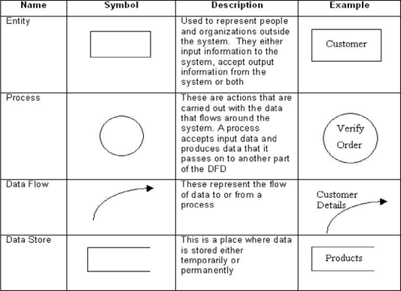
3.1 Data Flow Diagram (DFD)
The Data Flow Diagram (DFD) is a graphical representation of the flow of data through an information system. It enables you to represent the processes in your information system from the viewpoint of data. The DFD lets you visualize how the system operates, what the system accomplishes and how it will be implemented, when it is refined with further specification.
• Data flow diagrams are used by systems analysts to design informationprocessing systems but also as a way to model whole organizations. You build a DFD at the very beginning of your business process modeling in order to model the functions your system has to carry out and the interaction between those functions together with focusing on data exchanges between processes. You can associate data with conceptual, logical, and physical data models and object-oriented models.

Slide 13
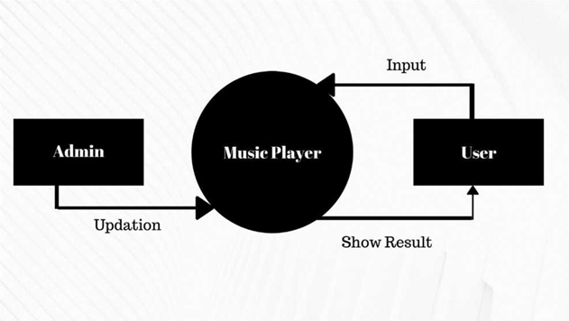
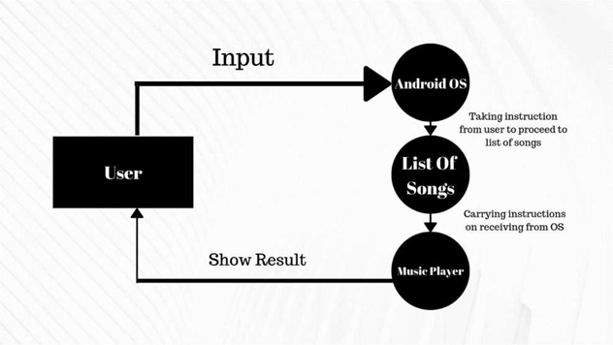
DFD Level 0 and DFD Level 1

Slide 14
In 0 level DFD, all type of user can able to start the application and music player returns the list of songs.
In 1 level DFD, user start the application on his android device and after taking instructions the android OS will proceed to list of songs and on clicking the particular song the music player will play the song.

Slide 15
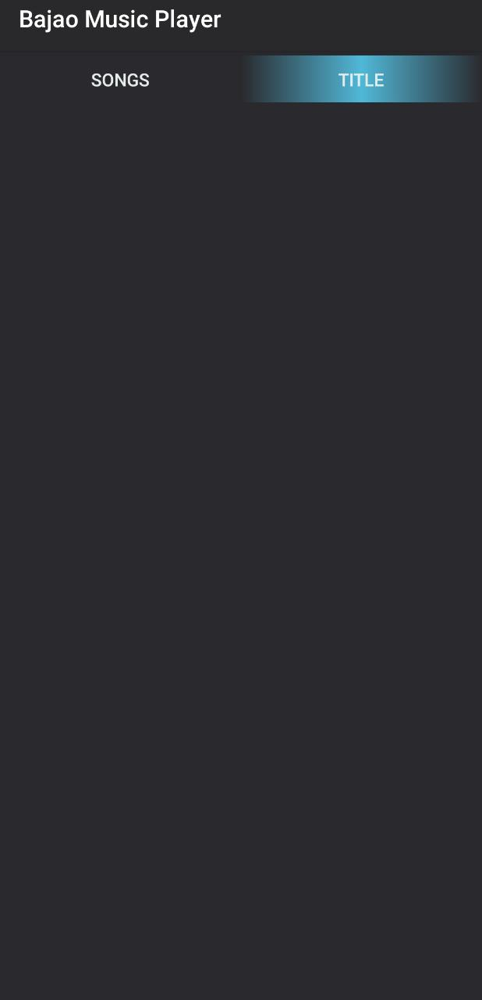
Bajao Music Player Font -

Slide 16
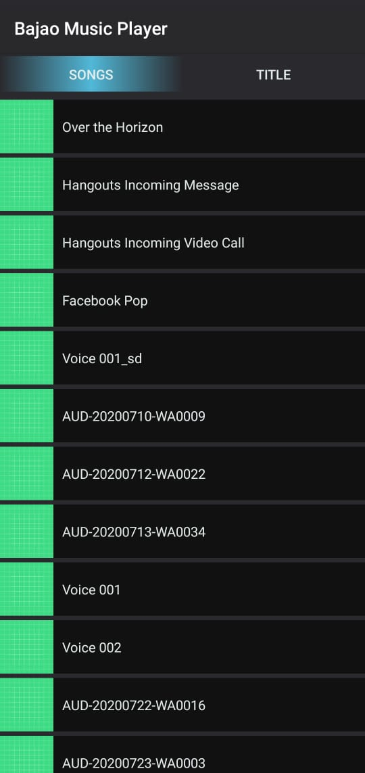
Bajao Music Player Songs Font Like This -

Slide 17
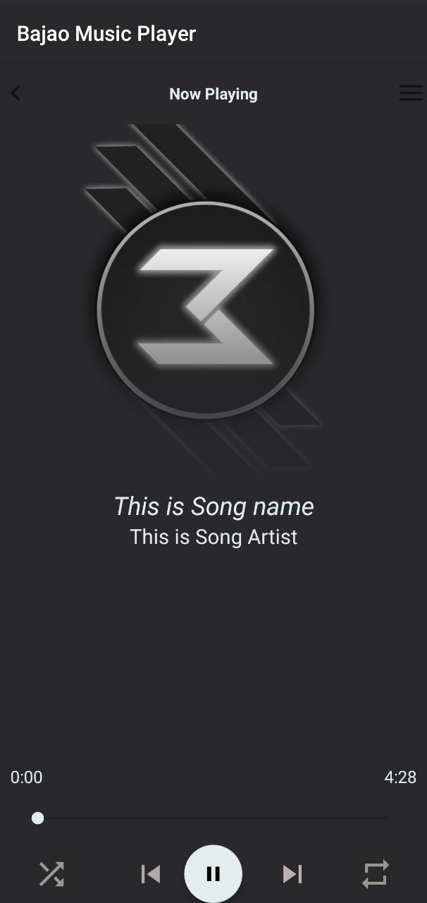
Overview of Bajao Music Player App -

Slide 18
Some of the code used in making Bajao Music Player App are- 1
<?xml version="1.0" encoding="utf-8"?>
<RelativeLayout xmlns:android="http://schemas.android.com/apk/res/android"
xmlns:app="http://schemas.android.com/apk/res-auto"
xmlns:tools="http://schemas.android.com/tools"
android:layout_width="match_parent"
android:layout_height="match_parent"
android:id="@+id/mContainer"
android:background="@drawable/main_bg"
android:orientation="vertical"
tools:context=".PlayerActivity">
<RelativeLayout
android:layout_width="match_parent"
android:layout_height="60dp"
android:id="@+id/layout_top_btn"
android:background="@drawable/gradient_bg"
android:layout_alignParentTop="true">
<ImageView
android:layout_width="30dp"
android:layout_height="30dp"
android:id="@+id/back_btn"
android:src="@drawable/ic_chevron_left"
android:layout_alignParentStart="true"
android:layout_centerVertical="true"/>
<TextView
android:layout_width="match_parent"
android:layout_height="wrap_content"
android:layout_centerVertical="true"
android:text="Now Playing"
android:textColor="@color/colorAccent"
android:layout_toEndOf="@id/back_btn"
android:layout_toStartOf="@id/menu_btn"
android:gravity="center_horizontal"
android:background="@android:color/transparent"
android:textStyle="bold"/>
<ImageView
android:layout_width="30dp"
android:layout_height="30dp"
android:id="@+id/menu_btn"
android:src="@drawable/ic_menu"
android:layout_alignParentEnd="true"
android:layout_centerVertical="true"/>
</RelativeLayout>

Slide 19
<RelativeLayout
android:layout_width="match_parent"
android:layout_height="350dp"
android:id="@+id/card"
android:layout_below="@id/layout_top_btn">
<ImageView
android:layout_width="match_parent"
android:layout_height="match_parent"
android:src="@drawable/image"
android:scaleType="centerCrop"
android:id="@+id/cover_art"/>
<ImageView
android:layout_width="match_parent"
android:layout_height="250dp"
android:id="@+id/imageviewgradient"
android:src="@drawable/gradient_bg"
android:layout_alignParentBottom="true"/>
</RelativeLayout>
<TextView
android:layout_width="match_parent"
android:layout_height="wrap_content"
android:id="@+id/songName"
android:text="This is Song name"
android:layout_below="@id/card"
android:textColor="@color/colorAccent"
android:gravity="center_horizontal"
android:textSize="22sp"
android:textStyle="italic"
android:ellipsize="end"
android:singleLine="true"
android:layout_marginStart="32dp"
android:layout_marginEnd="32dp"/>

Slide 20
<TextView
android:layout_width="match_parent"
android:layout_height="wrap_content"
android:id="@+id/artist_name"
android:text="This is Song Artist"
android:layout_below="@id/songName"
android:textColor="@color/colorAccent"
android:gravity="center_horizontal"
android:textSize="18sp"
android:ellipsize="end"
android:singleLine="true"
android:layout_marginStart="40dp"
android:layout_marginEnd="40dp"/>
<RelativeLayout
android:layout_width="match_parent"
android:layout_height="60dp"
android:id="@+id/Relative_layout_for_bottom"
android:layout_alignParentBottom="true"
android:layout_alignParentEnd="true"
android:background="@drawable/gradient_bg">
<ImageView
android:layout_width="35dp"
android:layout_height="35dp"
android:id="@+id/id_shuffle"
android:src="@drawable/ic_shuffle_off"
android:layout_centerVertical="true"
android:layout_alignParentStart="true"
android:layout_marginStart="32dp"/>
<ImageView
android:layout_width="35dp"
android:layout_height="35dp"
android:id="@+id/id_prev"
android:src="@drawable/ic_skip_previous"
android:layout_toStartOf="@id/play_pause"
android:layout_centerVertical="true"
android:layout_marginStart="16dp"/>

Slide 21
<ImageView
android:layout_width="35dp"
android:layout_height="35dp"
android:id="@+id/id_next"
android:src="@drawable/ic_skip_next"
android:layout_toEndOf="@id/play_pause"
android:layout_centerVertical="true"
android:layout_marginStart="16dp"/>
<com.google.android.material.floatingactionbutton.FloatingActionButton
android:layout_width="wrap_content"
android:layout_height="wrap_content"
android:id="@+id/play_pause"
android:src="@drawable/ic_play"
android:layout_centerHorizontal="true"
android:layout_centerVertical="true"
android:layout_marginStart="15dp"
android:layout_marginEnd="15dp"
android:focusable="true"
android:clickable="true"/>
</RelativeLayout>
<RelativeLayout
android:layout_width="match_parent"
android:layout_height="60dp"
android:layout_above="@id/Relative_layout_for_bottom"
android:id="@+id/seek_bar_layout"
android:layout_marginBottom="15dp">
<TextView
android:layout_width="wrap_content"
android:layout_height="wrap_content"
android:layout_marginStart="10dp"
android:text="0:00"
android:id="@+id/duration_played"
android:textColor="@color/colorAccent"
android:textSize="15sp"
android:layout_alignParentStart="true"/>

Slide 22
<TextView
android:layout_width="wrap_content"
android:layout_height="wrap_content"
android:layout_marginEnd="10dp"
android:text="4:28"
android:id="@+id/total_duration"
android:textColor="@color/colorAccent"
android:textSize="15sp"
android:layout_alignParentEnd="true"/>
<SeekBar
android:layout_width="match_parent"
android:layout_height="wrap_content"
android:id="@+id/seek_bar"
android:layout_marginStart="20dp"
android:layout_marginEnd="20dp"
android:layout_alignParentBottom="true"/>
</RelativeLayout>
</RelativeLayout>

Slide 23
2
package com.example.musicplayer;
public class MusicFiles
{
private String path;
private String titles;
private String artist;
private String album;
private String duration;
public MusicFiles(String path, String titles, String artist, String album, String duration) {
this.path = path;
this.titles = titles;
this.artist = artist;
this.album = album;
this.duration = duration;
}
public MusicFiles()
{
}
public String getPath() {
return path;
}
public void setPath(String path) {
this.path = path;

Slide 24
}
public String getTitles() {
return titles;
}
public void setTitles(String titles) {
this.titles = titles;
}
public String getArtist() {
return artist;
}
public void setArtist(String artist) {
this.artist = artist;
}
public String getAlbum() {
return album;
}
public void setAlbum(String album) {
this.album = album;
}
public String getDuration() {
return duration;
}
public void setDuration(String duration) {
this.duration = duration;
}
}

Slide 25
3
<?xml version="1.0" encoding="utf-8"?>
<LinearLayout xmlns:android="http://schemas.android.com/apk/res/android"
xmlns:app="http://schemas.android.com/apk/res-auto"
xmlns:tools="http://schemas.android.com/tools"
android:orientation="vertical"
android:layout_width="match_parent"
android:layout_height="match_parent"
tools:context=".MainActivity">
<com.google.android.material.tabs.TabLayout
android:layout_width="match_parent"
android:layout_height="wrap_content"
android:background="@color/colorPrimaryDark"
android:id="@+id/tabLayout"
app:tabIndicatorFullWidth="true"
app:tabIndicatorGravity="center"
app:tabTextColor="@color/colorAccent"
app:tabIndicatorHeight="40dp"
app:tabIndicatorColor="#51B8D8"
app:tabIndicator="@drawable/tabindicator"
/>
<androidx.viewpager.widget.ViewPager
android:layout_width="match_parent"
android:layout_height="match_parent"
android:id="@+id/viewpager"/>
</LinearLayout>

Slide 26
Software Testing -
5.1 Testing
• Software testing is the process of executing a program with intension of finding errors in the code. It is a process of evolution of system or its parts by manual or automatic means to verify that it is satisfying specified or requirements or not.
• Generally, no system is perfect due to communication problems between user and developer, time constraints, or conceptual mistakes by developer.
• To purpose of system testing is to check and find out these errors or faults as early as possible so losses due to it can be saved.
• Testing is the fundamental process of software success.
• Testing is not a distinct phase in system development life cycle but should be applicable throughout all phases i.e. design development and maintenance phase.
• Testing is used to show incorrectness and considered to success when an error is detected.
5.2 Objectives of Software Testing
• Software Quality Improvement: The computer and the software are mainly used for complex and critical applications and a bug or fault in software causes severe losses. So a great consideration is required for checking for quality of software.
• Verification And Validation:
• Verification means to test that we are building the product in right way .i.e. are we using the correct procedure for the development of software so that it can meet the user requirements.
• Validation means to check whether we are building the right product or not.

Slide 27
• Software Reliability Estimation:
The objective is to discover the residual designing errors before delivery to the customer. The failure data during process are taken down in order to estimate the software reliability
5.3 Principles of Software Testing
• All tests should be traceable to end user requirements.
• Tests should be planned long before testing begins
• Testing should begin on a small scale and progress towards testing in large
• To be most effective testing should be conducted by an independent third party
The primary objective for test case design is to derive a set of tests that has the highest livelihood for uncovering defects in software. To accomplish this objective two different categories of test case design techniques are used. They are
• White box testing.
• Black box testing.
5.3.1 White-box testing:
White box testing focus on the program control structure. Test cases are derived to ensure that all statements in the program have been executed at least once during testing and that all logical conditions have been executed.
5.3.2 Black-box testing:
Black box testing is designed to validate functional requirements without regard to the internal workings of a program. Black box testing mainly focuses on the information domain of the software, deriving test cases by partitioning input and output in a manner that provides through test coverage. Incorrect and missing functions, interface errors, errors in data structures, error in functional logic are the errors falling in this category.

Slide 28
5.4 Testing fundamentals
Testing is a process of executing program with the intent of finding error. A good test case is one that has high probability of finding an undiscovered error. If testing is conducted successfully it uncovers the errors in the software. Testing cannot show the absence of defects, it can only show that software defects present.
5.5 Testing Information flow
Information flow for testing flows the pattern. Two class of input provided to test the process. The software configuration includes a software requirements specification, a design specification and source code.
Test configuration includes test plan and test cases and test tools. Tests are conducted and all the results are evaluated. That is test results are compared with expected results. When erroneous data are uncovered, an error is implied and debugging commences.

Slide 29
Conclusion -
This was the first considerably large and important project undertaken by me during my B.Tech course. It was an experience that changed the way we perceived project development. The coding could not be started before the whole system was completely finalized. Even then there were so many changes required and the coding needed to be changed. We attribute this to inadequate information gathering from the user. Though there were many meetings with the user and most of the requirements were gathered, a few misinterpretations of the requirements still crept in. It made us realize how important the systems analysis phase is. The project is a classic example, that learning of concepts needs to be supplemented with application of that knowledge.
On the whole it was a wonderful experience developing Bajao Music Player and we would have considered our education incomplete without undertaking such a project which was not an easy task for us without the support of our guide.
An easy well-structured module will show the correct path to reach the destination. Users will be authenticated to ensure that no unauthorized users gain access to private information

Slide 30
Bibliography And Reference
To develop this android application of Music Player, I used Java and XML Language. I take some knowledge towards automation system from book that is given below:
• Java- The Complete Reference- by Herbert Schildt
Reference -
[1] . www.stackoverflow.com
[2] . www.javatpoint.com

